Slide 1
Stoichiometry Lab
Mass-Mass and Limiting Reactant

Slide 2
Purpose
In this lab, you will determine the reaction for mixing two reactants together.
You will then measure out 0.005 moles of each reactant. You will dissolve, mix, and react them to make products.
You will compare the amount you produced at the end with the amount you expected to get using stoichiometry.

Slide 3
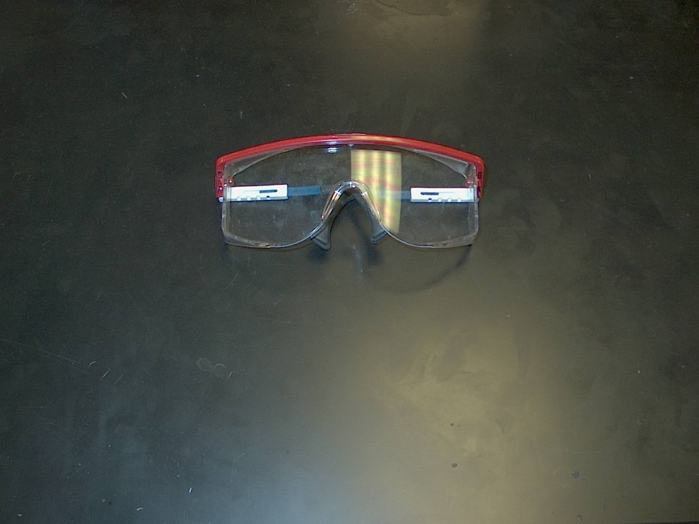
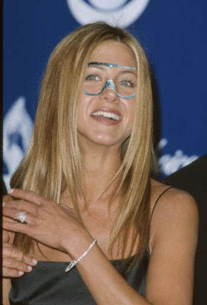
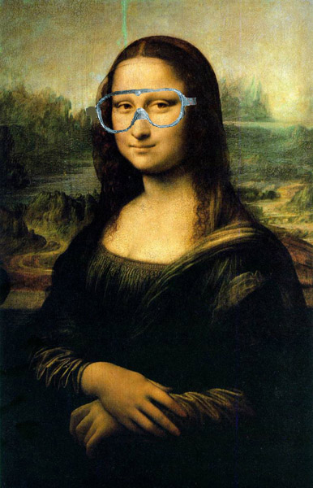
Put on your safety goggles!

Slide 4
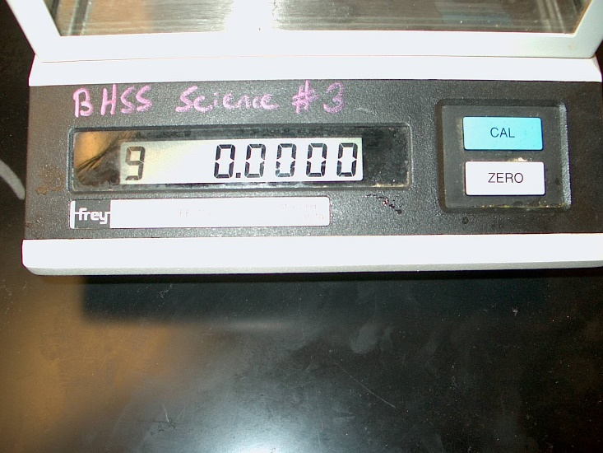
Obtain the reactants.
Put the lid back on the bottle! Use a clean spatula from your box to dip into the chemical! Never touch lab chemicals with your hands!
Be sure to wait after you push the ZERO button until it reads 0.0000 g before you make a measurement (don’t hit CAL!)

Slide 5
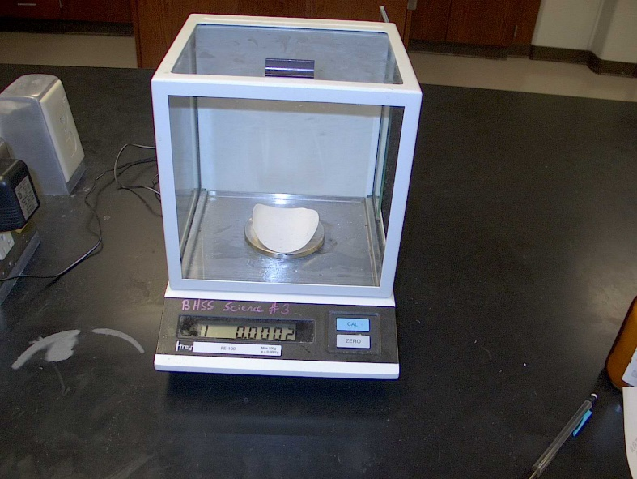
Obtain the reactants.
You can either 1) zero the balance with the weighing paper, or 2) get a mass of the weighing paper and subtract.
Don’t waste time trying to get the exact amount needed… instead get close BUT WRITE DOWN THE ACTUAL AMOUNT!
Keep the balance and the desktop clean of lab chemicals! Clean up the SLIGHTEST spill with a paint brush and dispose of it properly!

Slide 6
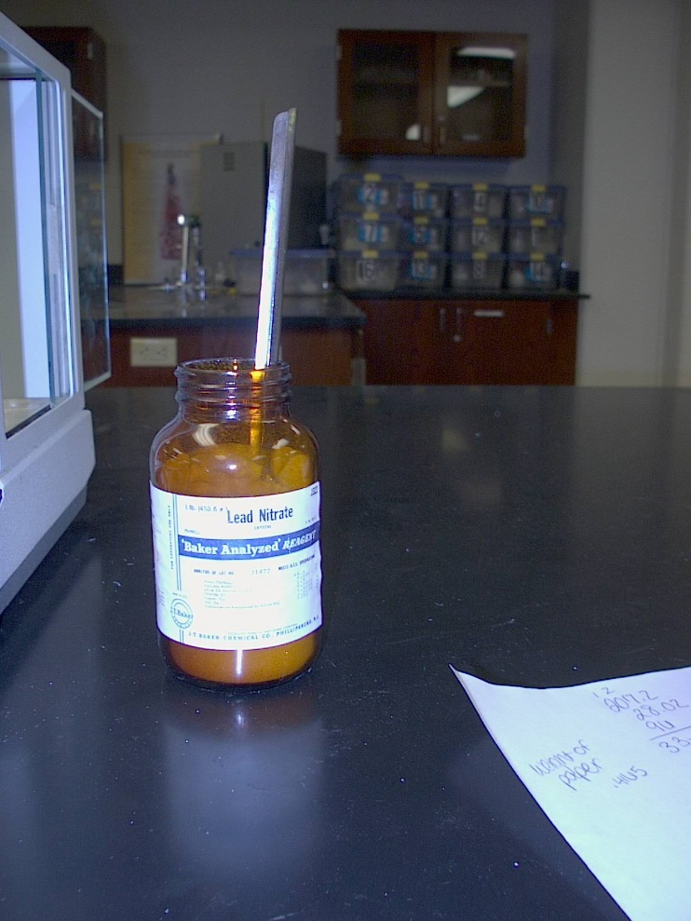
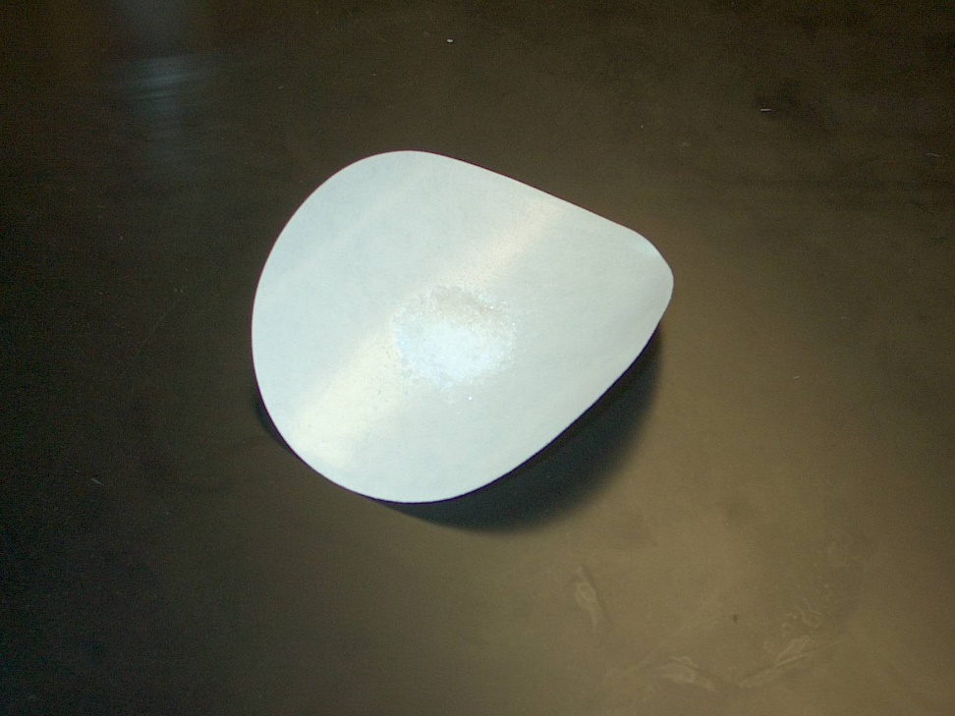
Obtain the lead (II) nitrate.

Slide 7
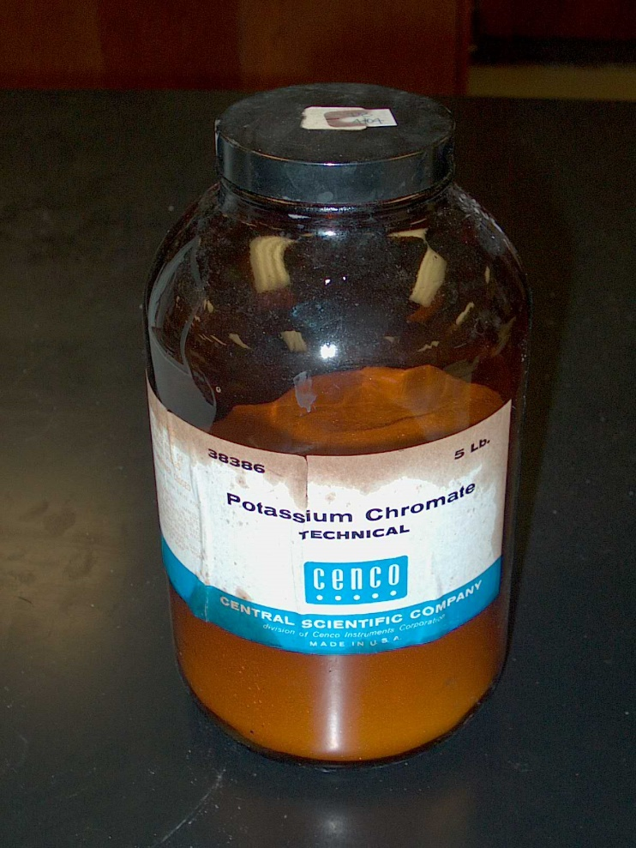
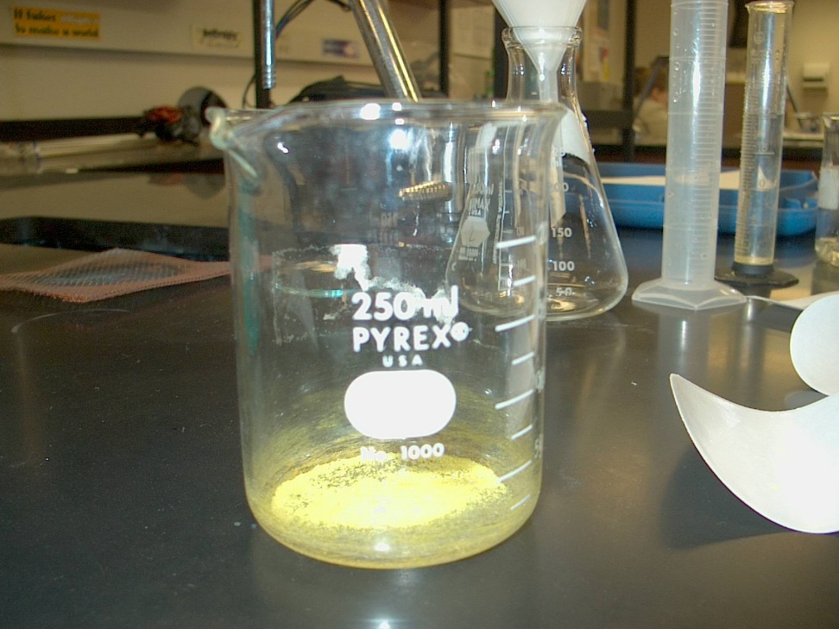
Obtain the potassium chromate.
Be sure to get the mass of the EMPTY beaker before you dump the potassium chromate into the beaker!

Slide 8
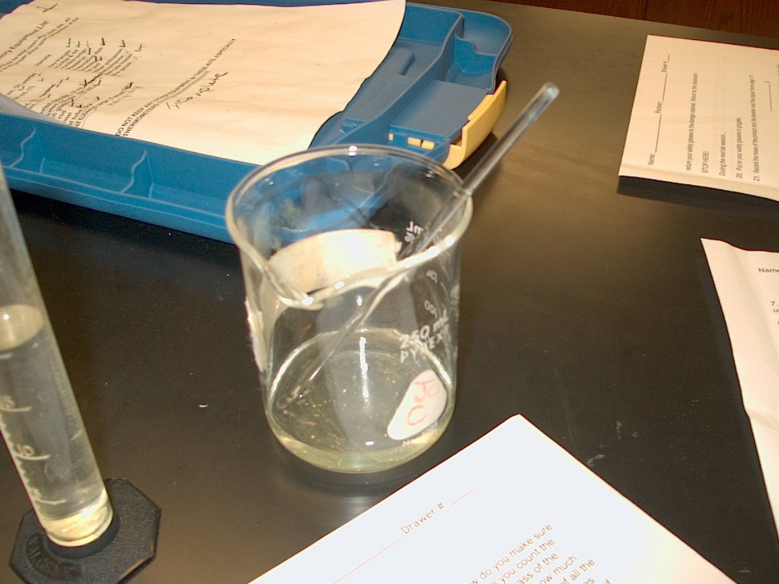
Dissolve the reactants in water.
Dissolve the lead (II) nitrate in a beaker with a specified amount of water. In another beaker, do the same with the potassium chromate.

Slide 9
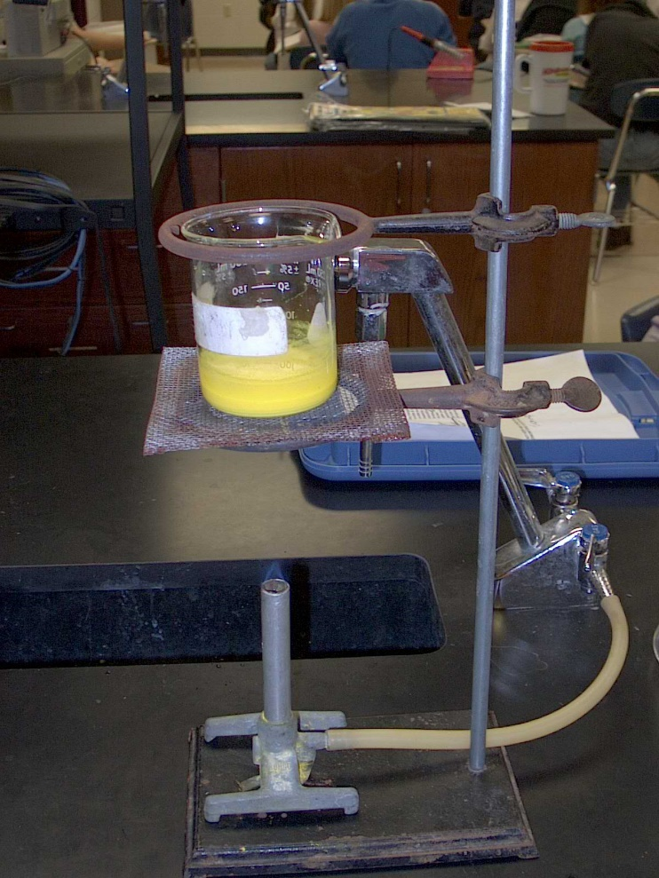
Slowly mix the chemicals.
Be sure to pour INTO the beaker that you massed, while stirring.
Assemble a ring stand and bunsen burner as shown here.
SLIGHTLY warm the mixture for a few minutes.

Slide 10
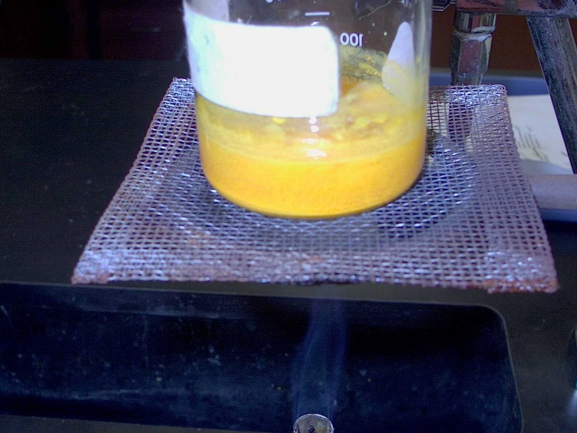
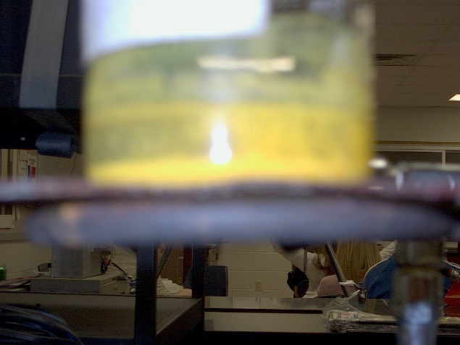
When is it done?
The reaction should be complete when the color is orange rather than bright yellow.
The solid may “poof” a little during heating like in this picture. If the reaction is gurgling, TURN OFF THE HEAT!

Slide 11
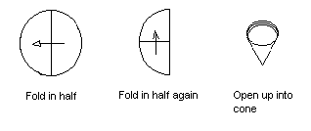
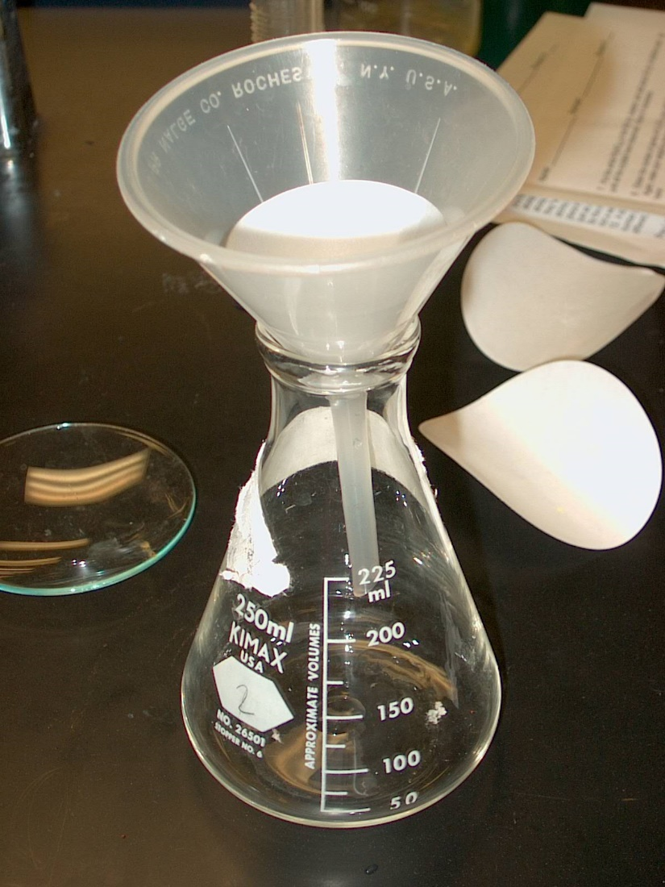
Filter the products.
One of the products is an orange precipitate (a solid that forms by mixing two liquids).
The other product is soluble in water. You will not be able to see this product.
Separate the two products by filtering through a paper funnel. The liquid will pass through, but the solid will not.
Be sure to get the mass of the filter paper BEFORE you filter!

Slide 12
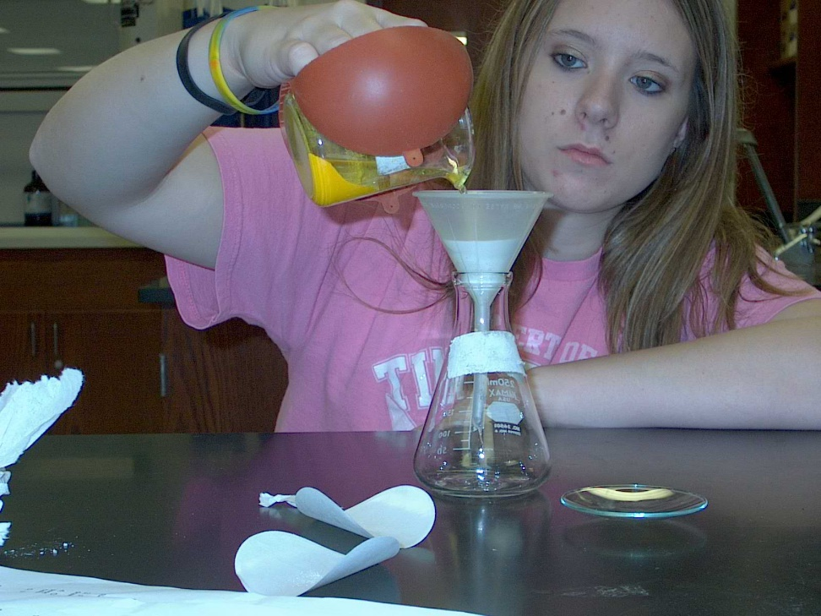
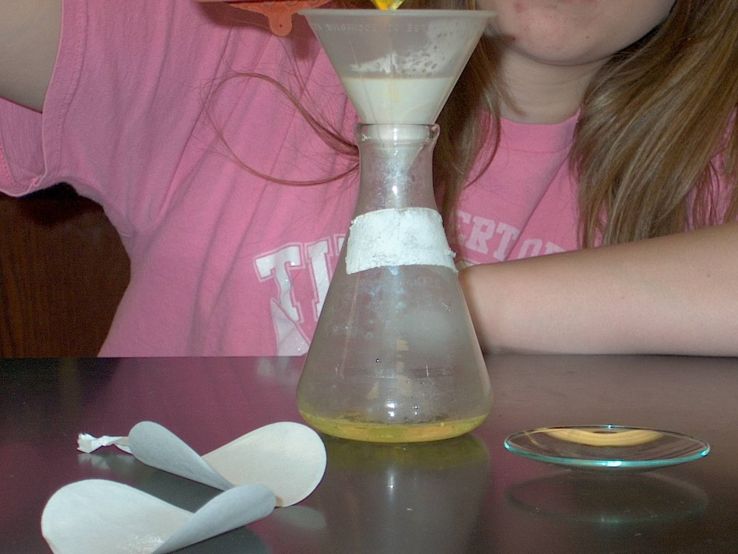
Filtering
The trick to fast filtering is to keep all the solid in the beaker as possible. Let the solid settle to the bottom, and pour the water through the paper funnel. Catch the liquid in an Erlenmeyer flask, as shown here. The paper will catch any solid that accidentally gets away from you. If you try to pour all of the solid in, it will take HOURS for you to filter.

Slide 13
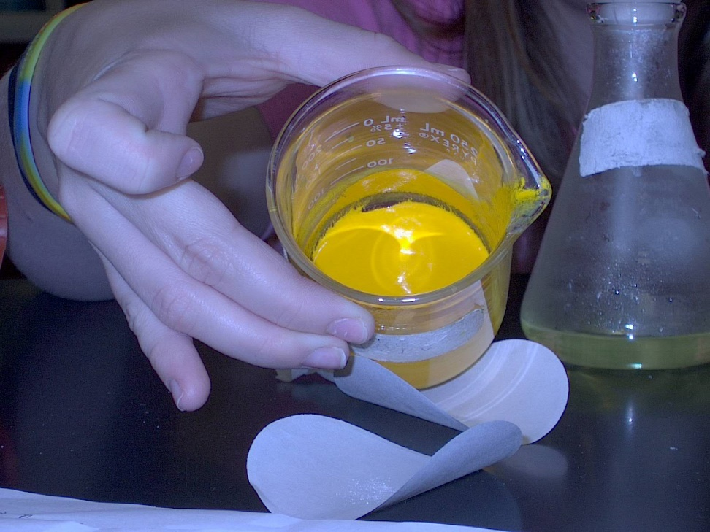
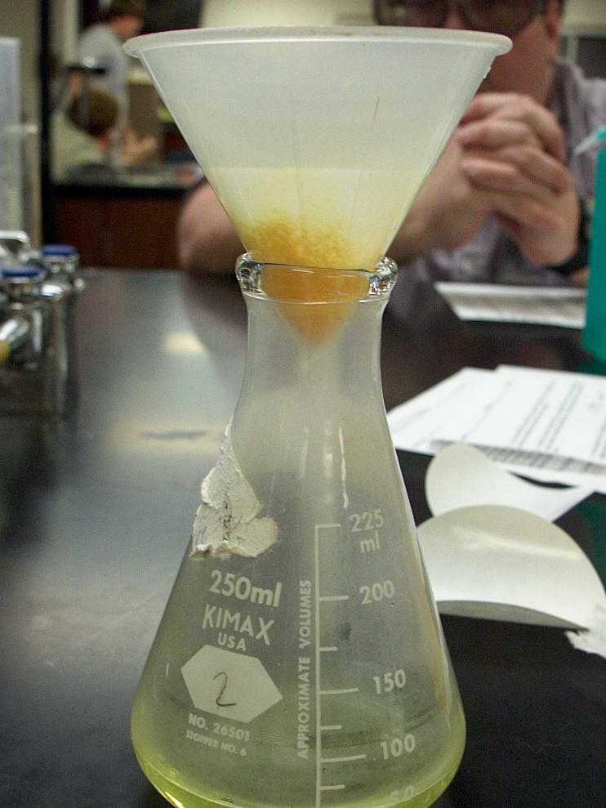
Filtering
This is what it should look like when you are finished filtering.

Slide 14
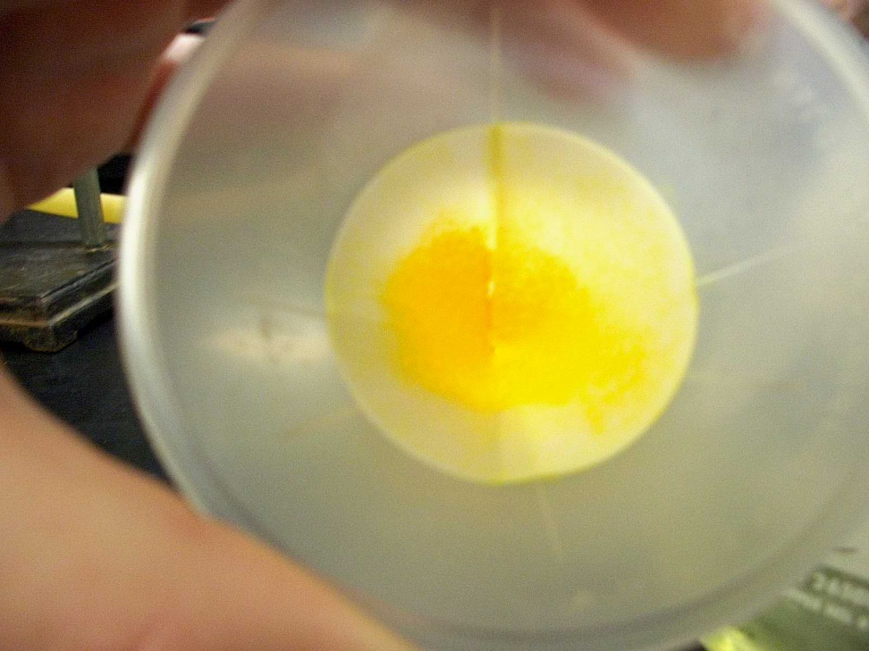
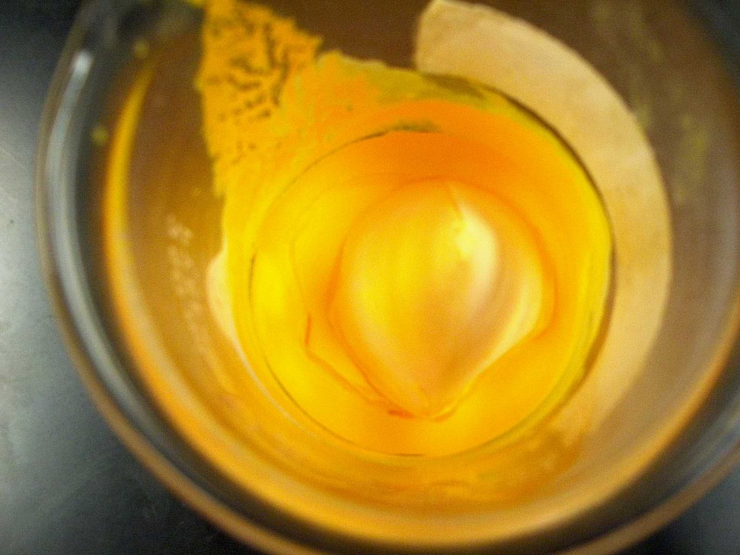
Combine the orange product.
Remove the filter paper from the funnel with your forceps. Drop it into the beaker with the rest of the orange precipitate.

Slide 15
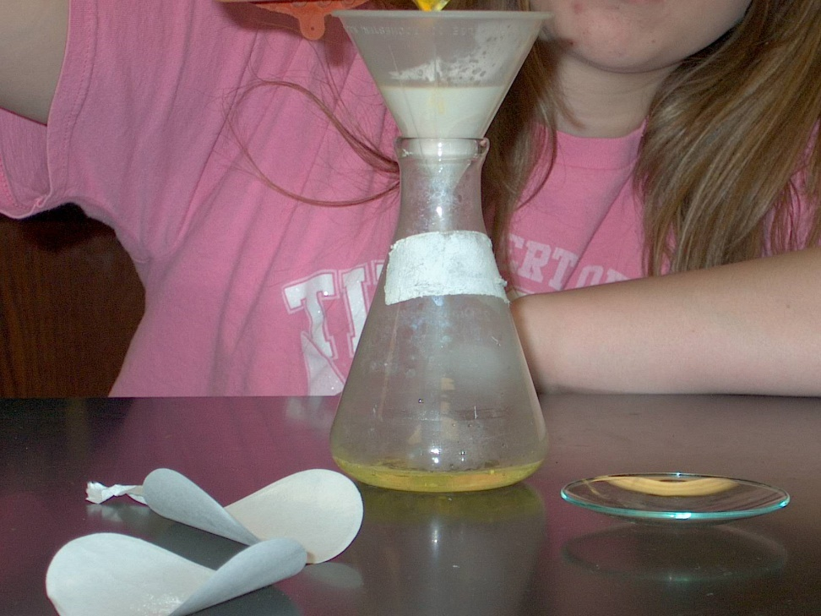
Save your product and filtrate.
Place your beaker with the precipitate and filter paper into the oven to dry overnight.
Put a cork or rubber stopper in the flask that holds the filtrate (liquid). Label it, and store until the next lab session.

Slide 16
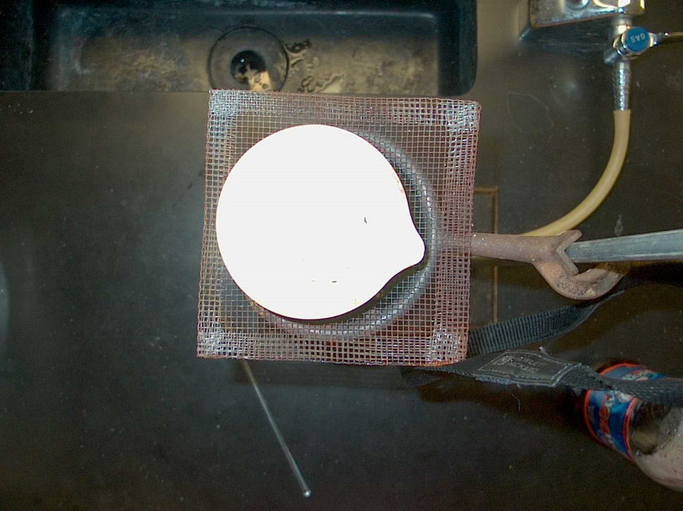
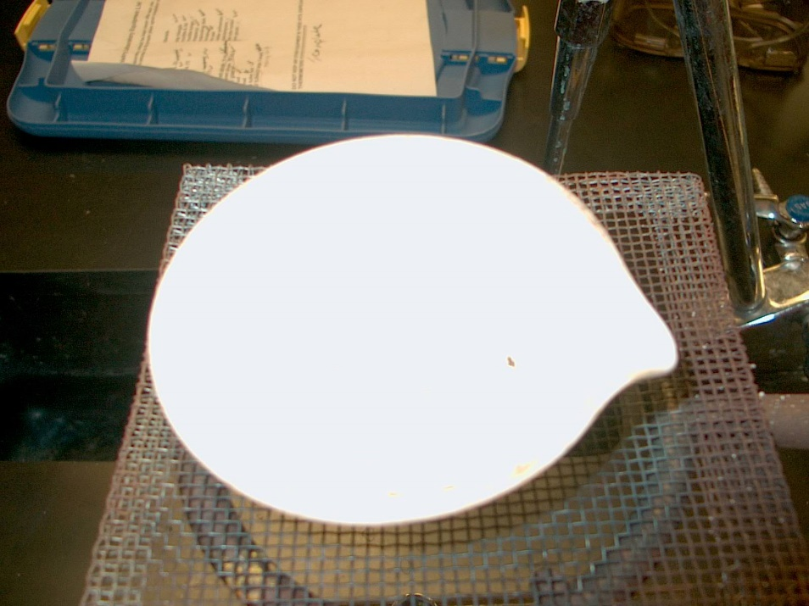
Day Two
Get the mass of the beaker with the filter paper and precipitate. Use the SAME balance as before.
Evaporate PART of your filtrate using an evaporating dish on a ring stand. Note there is a second product! With the water all evaporated, you can see the other product in solid form!

Slide 17
% error
Experimental yield – Theoretical yield
Theoretical yield
X 100 = % error
What you predicted you would get (use stoichiometry)
What YOU got in the experiment

Slide 18
% yield
Experimental yield
Theoretical yield
X 100 = % yield

